Slide 1







Pessimist's Archive
Umbrellas

Slide 2
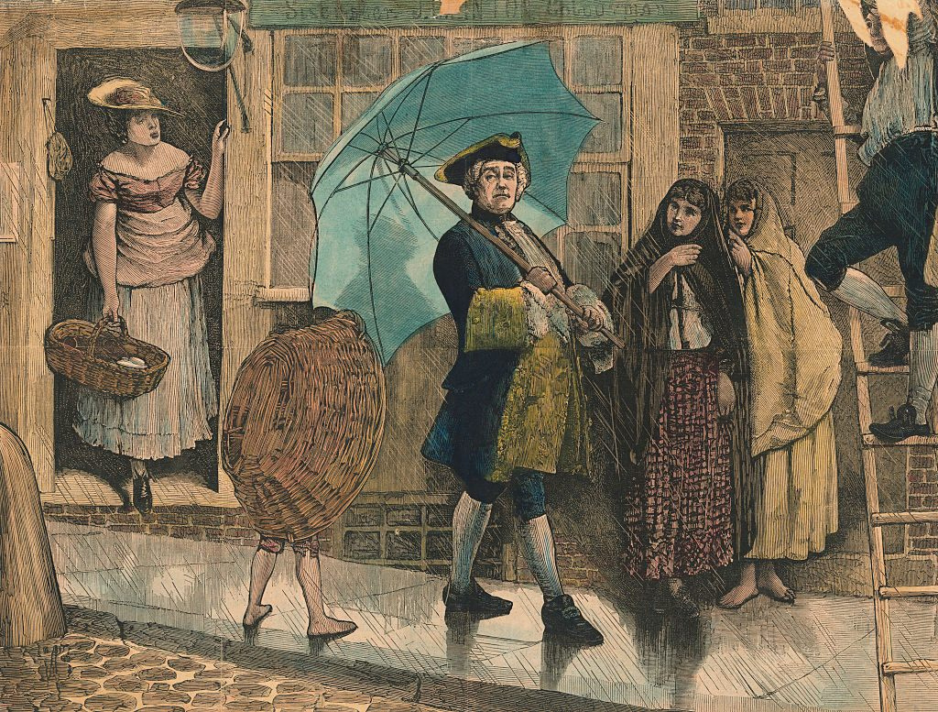
JONAS HANWAY
ONE OF THE FIRST MEN TO HOLD AN UMBRELLA IN LONDON
Notes:
Jonas Hanway (1712–1786) was an English philanthropist, writer, and traveler, best known for his humanitarian efforts and for being one of the first men in London to use an umbrella publicly—something that was considered unusual at the time.
The public thought it was ridiculous. A cab driver tried to run him over and he tried to beat the cab driver up sing his umbrella (purr)

Slide 3



NOTES AND QUERIES
“When Men began to use umbrellas, they were hooted and jeered at as Frenchmen”
Notes:
Notes and Queries is like twitter. a long-running scholarly journal that publishes short articles, notes, and questions related to various fields, especially literature, history, and the humanities.
The brits associated umbrellas with the French.

Slide 4



CLASSISM
“The umbrella is a sign of having no carriage”

Slide 5


THE GRAND TOUR
Young Englishmen tourd around the world to study and they found out that the world was not as rainy as England
Notes:
The brits spent years saying thank you, but no thank you. They made them who they were But that's not the only cultural problem

Slide 6




VLADIMIR JANKOVIC
Confronting the Climate
“People rejecting any effort to change their personal climates”
Notes:
Yankovich. People rejecting any effort to change their personal climates and Umbrellas were a crucial point. There was something unnatural with trying to control the air around them. A nurse once refused to use an air pumping machine.

Slide 7
ADOPTED BY WORKING CLASS WOMEN
“Commonly used by women to shelter them from the rain”
Notes:
This seemed acceptable by them

Slide 8




“UGLY” UMBRELLA
Notes:
Robinson Crusoe (1719) by Daniel Defoe. The story is about an Englishman who gets shipwrecked on a deserted island and survives there for 28 years. He builds shelter, grows food, tames animals, and even makes an umbrella out of goat skin to protect himself from the sun.

Slide 9
JONAS HANWAY
Notes:
A merchant published 4 books about trade
Jonas Hanway (he didn’t like tea?)
The umbrella was helped out by cultural changes

Slide 10




HAVE WE GOTTEN PAST THE STIGMA BEHIND UMBRELLAS?

Slide 11





No.
Notes:
In the Marines, Men are not allowed to carry around umbrellas in the marines but women are

Slide 12





“The way you face the reality is to ignore it”
(Don’ take this the wrong way)
Notes:
Robinson Crusoe

Slide 13




“When you live under the rain, it becomes useless. It’s more comfortable to get wet.”
Notes:
It’s okay to say “it isn’t for me” but it’s not okay to ask others not to use it.

Slide 14
Thank You!

